Slide 1
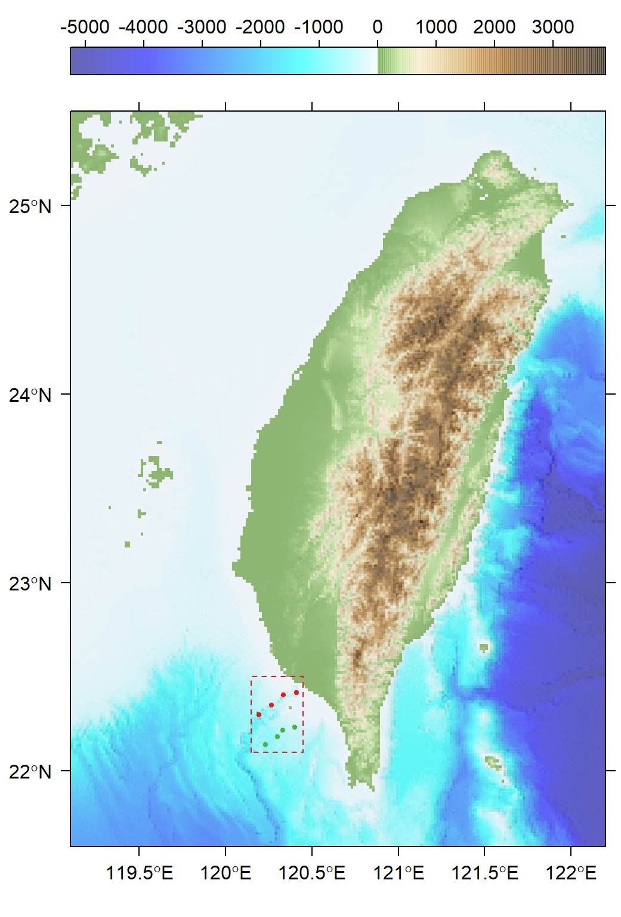
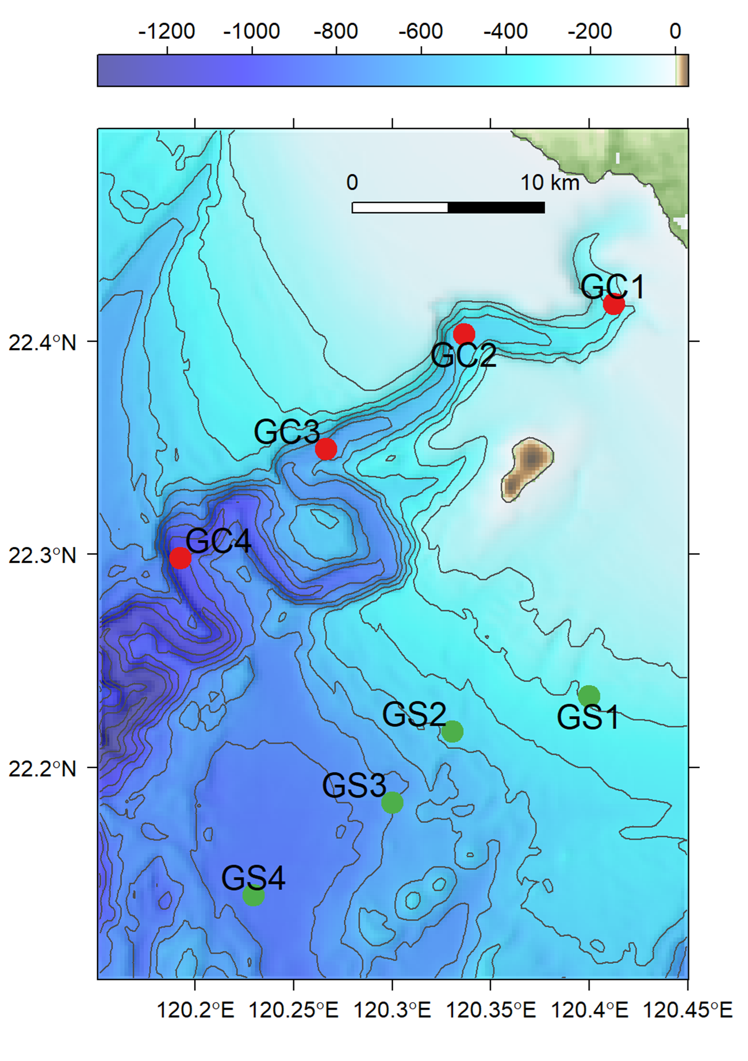
(A)
(B)
Notes:
Fig. 1 Sampling map of meiobenthos and macrobenthos

Slide 2
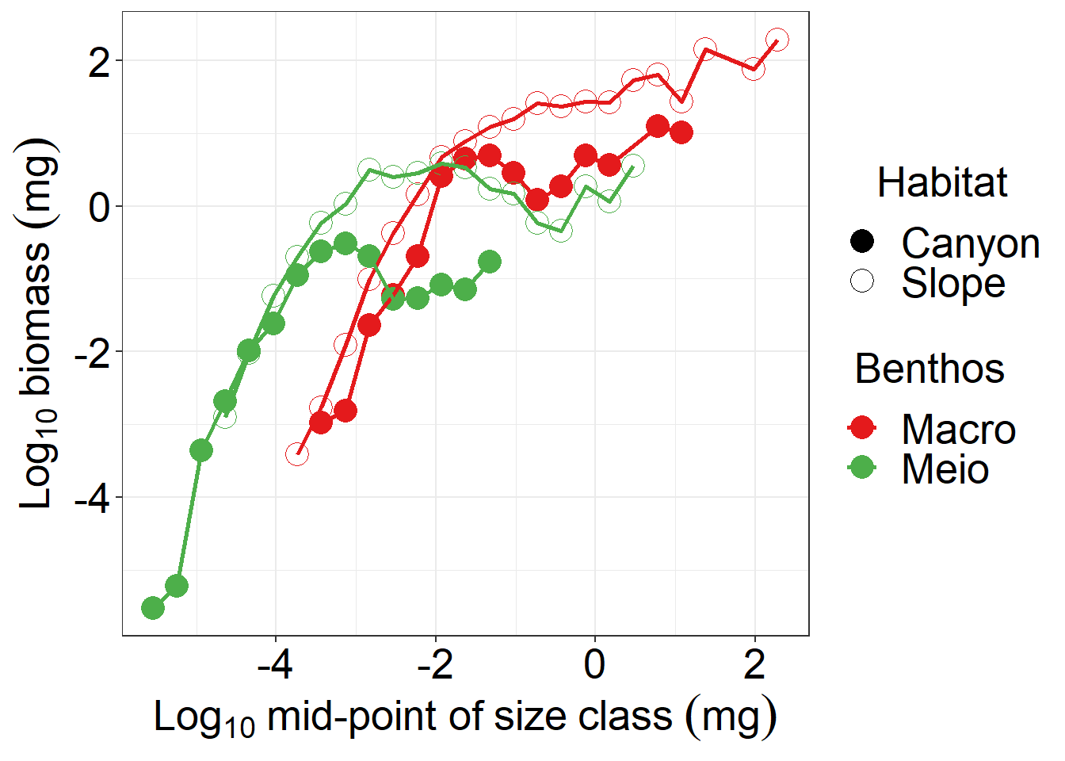
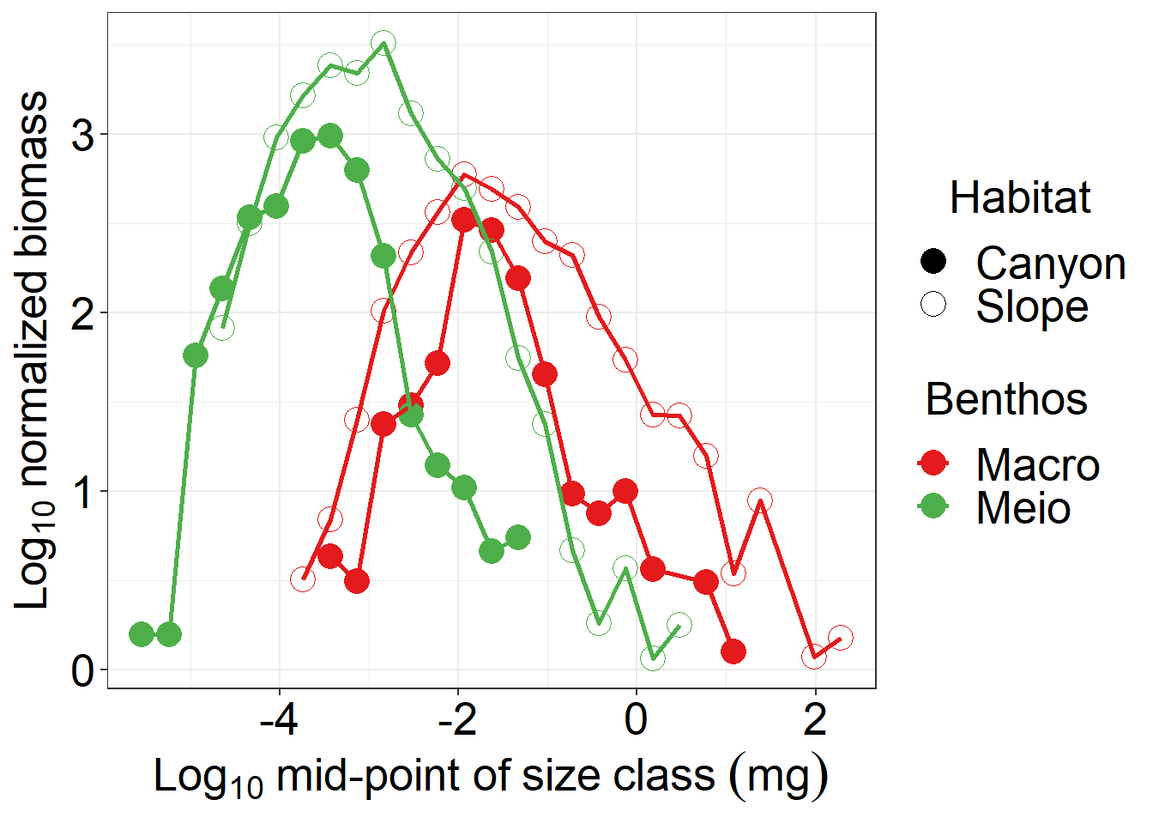
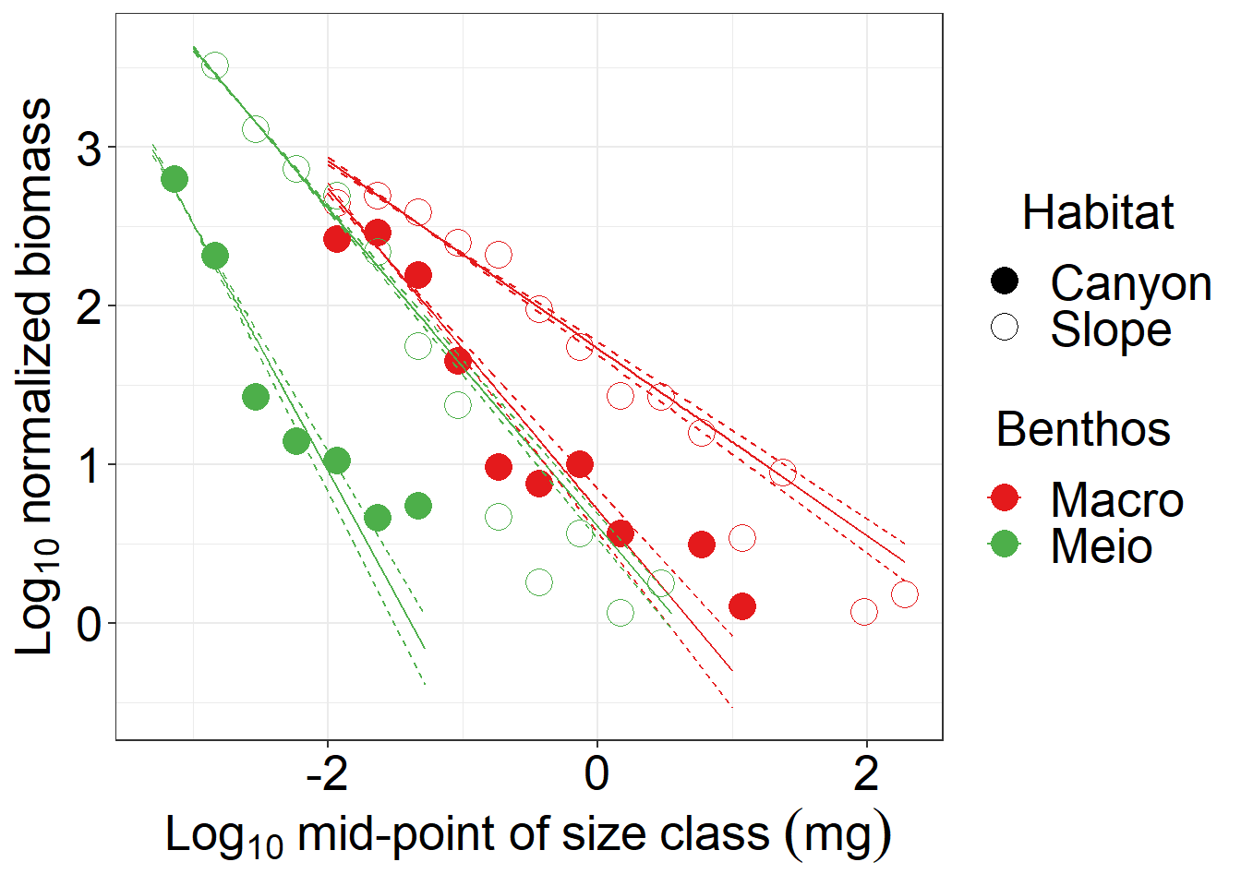
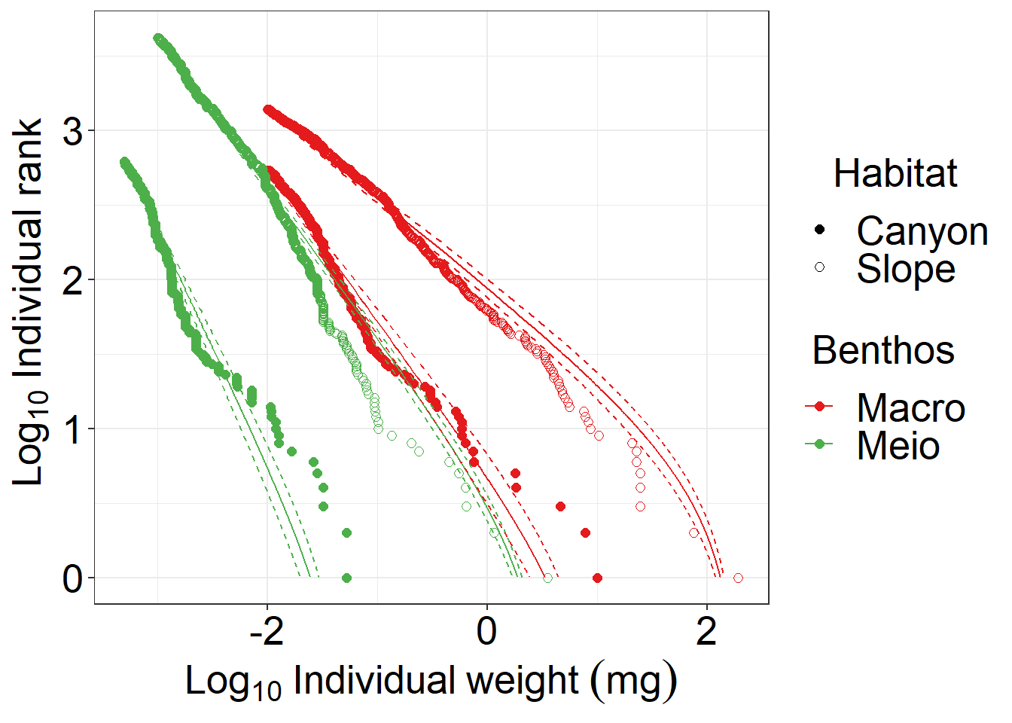
(A)
(B)
(C)
(D)
Notes:
Fig. 2 Size spectrum of meiobenthos and macrobenthos.

Slide 3
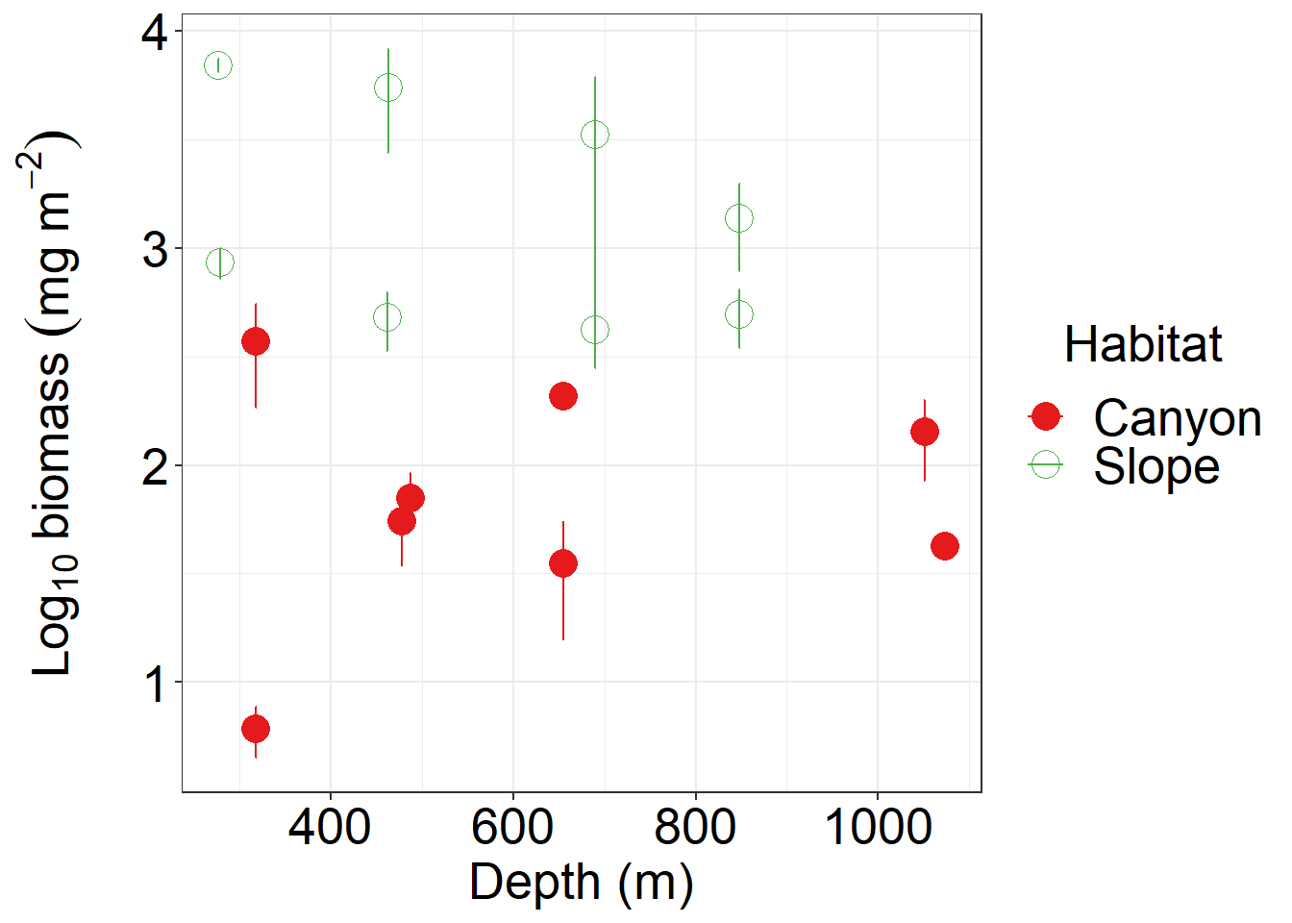
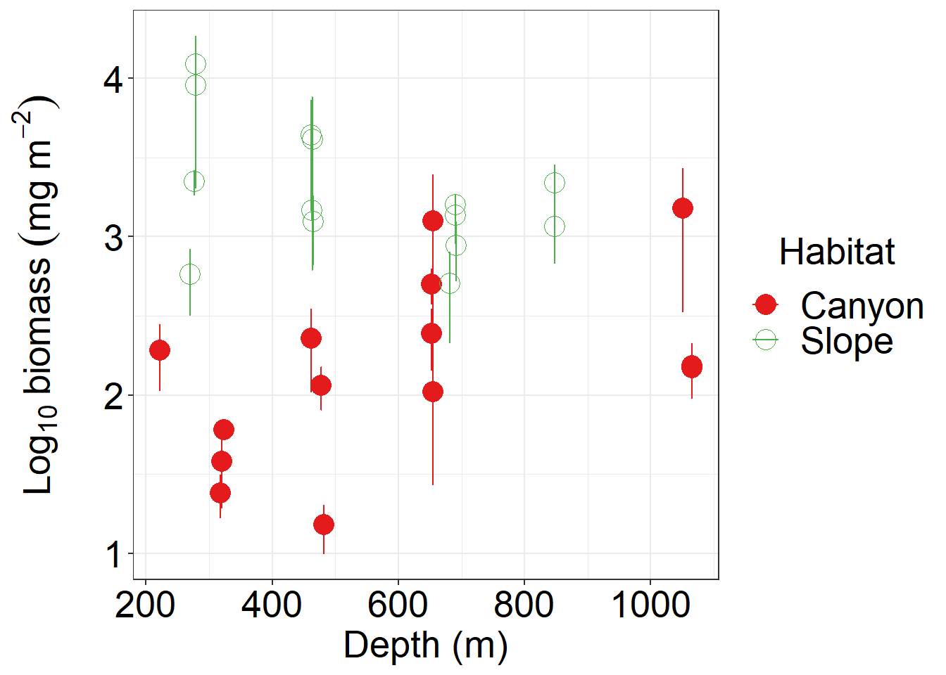
(A)
(B)
Notes:
Fig. 3. Biomass, annual P/B ratio, annual secondary production of meiobenthos (A, C, E) and macrobenthos (B, D, F)

Slide 4
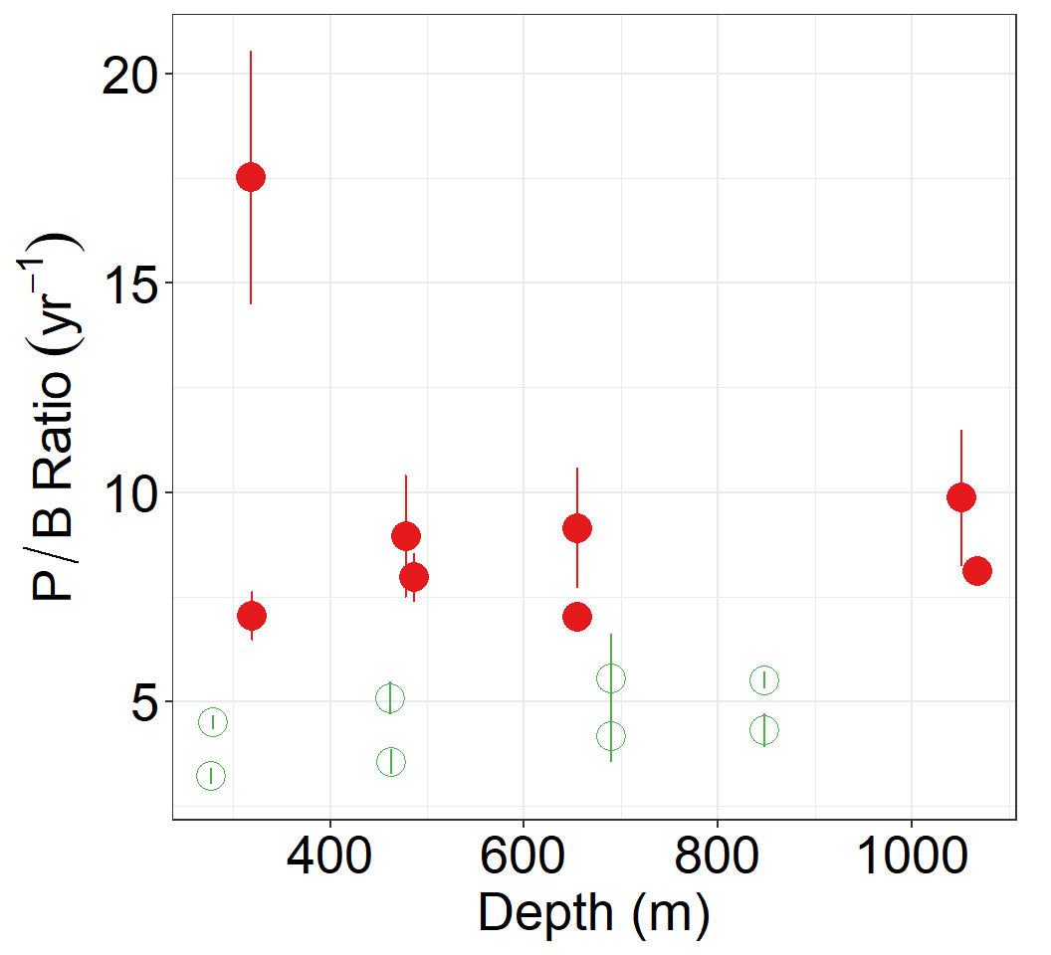
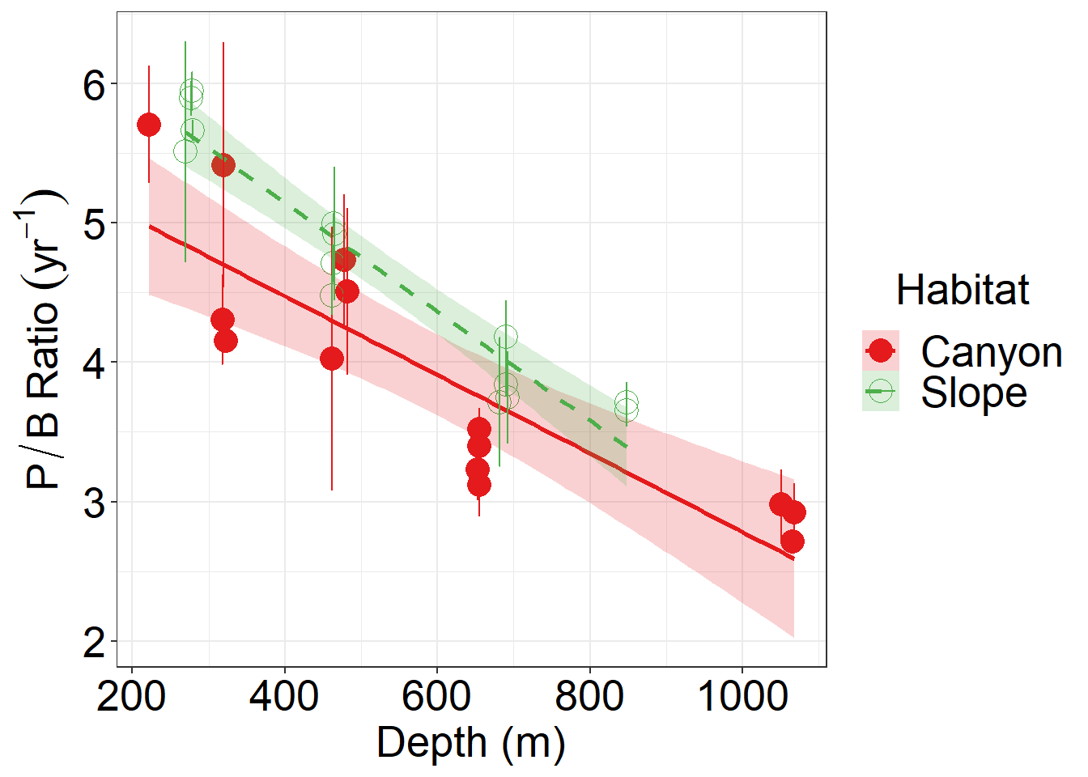
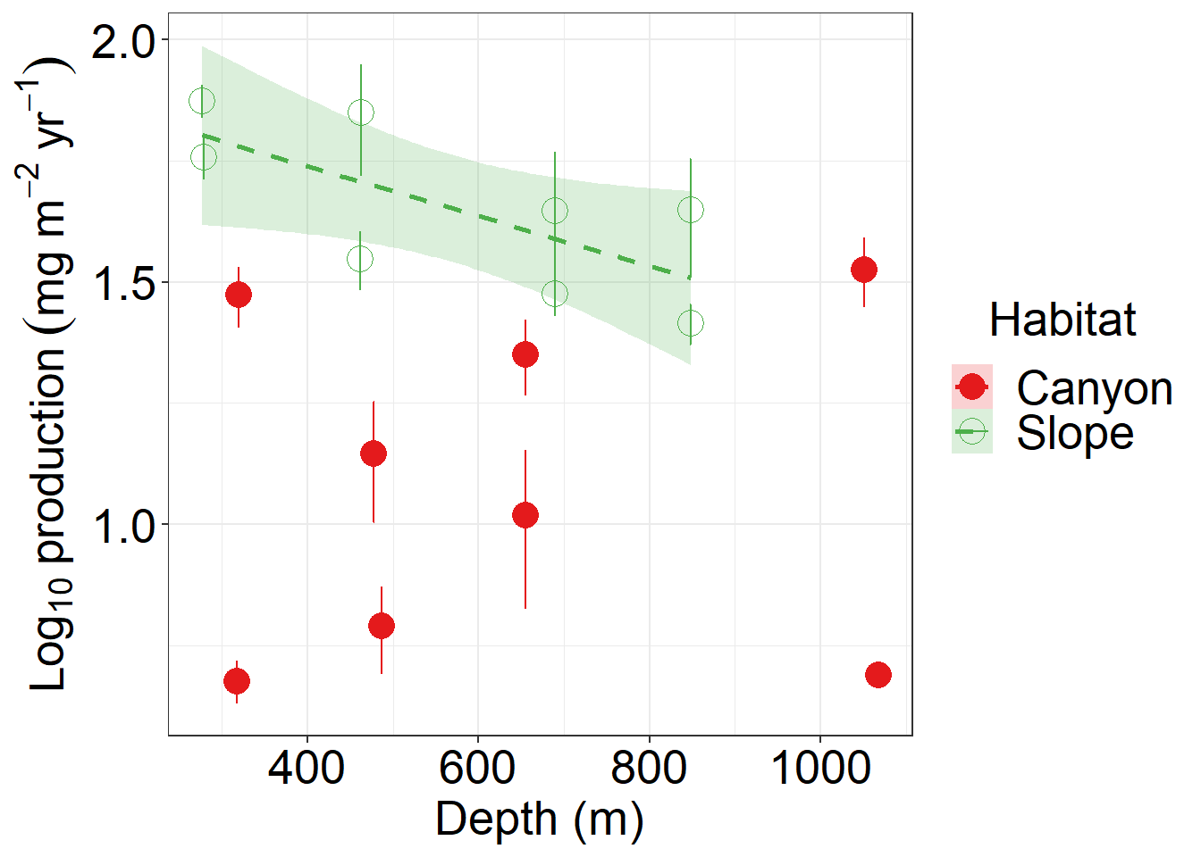
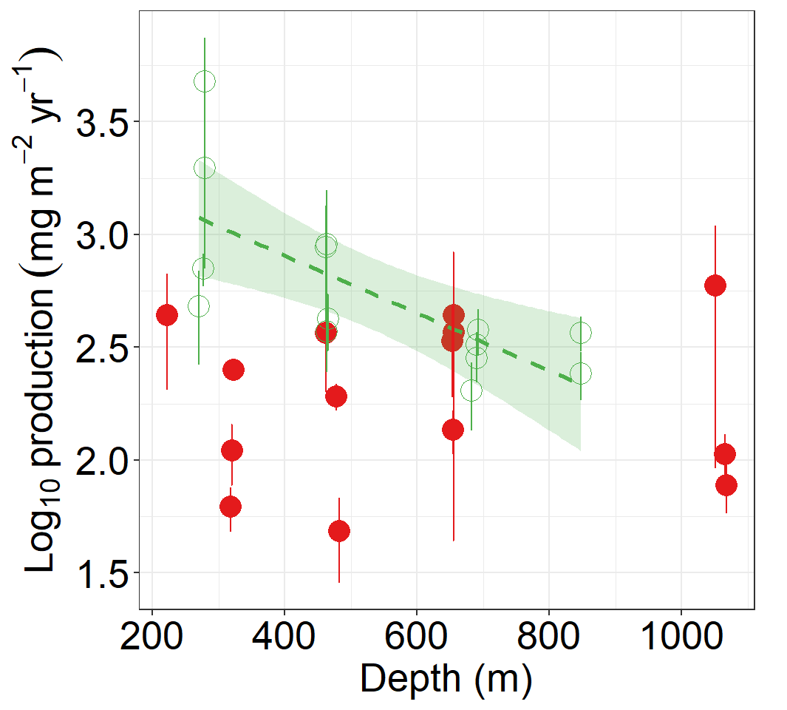
(A)
(B)
(C)
(D)
Notes:
Fig. 4. Annual P/B ratio, annual secondary production of meiobenthos (A, C, E) and macrobenthos (B, D, F)

Slide 5
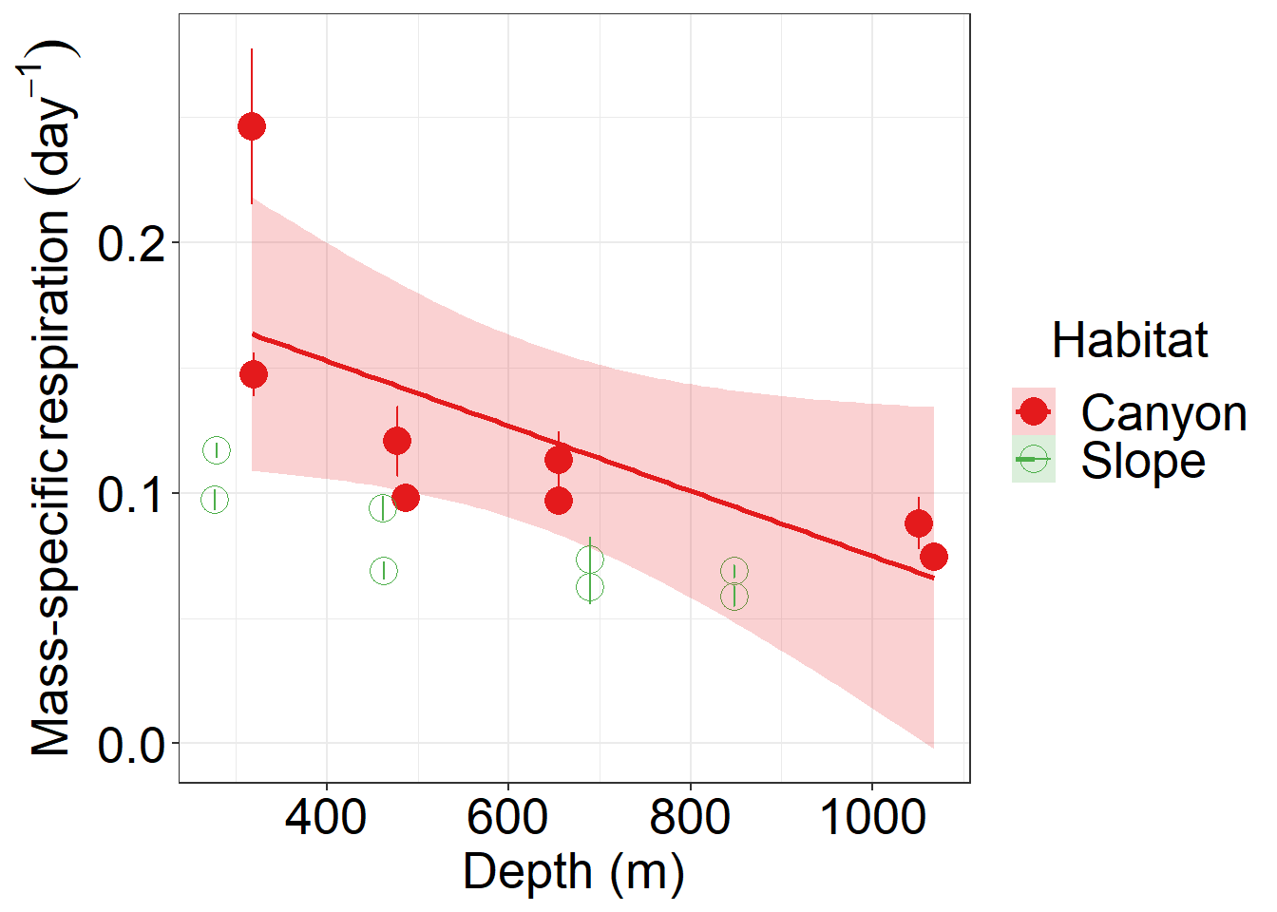
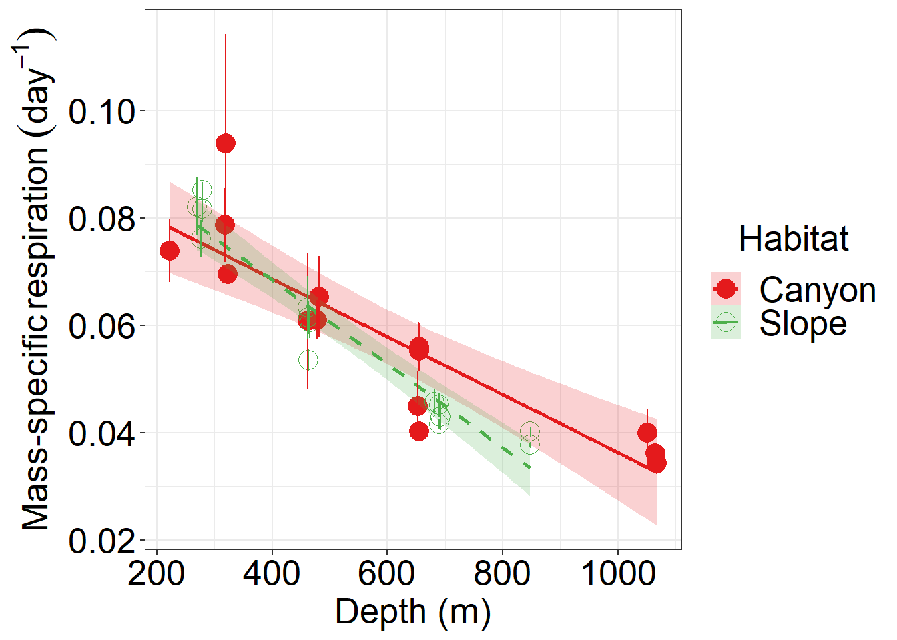
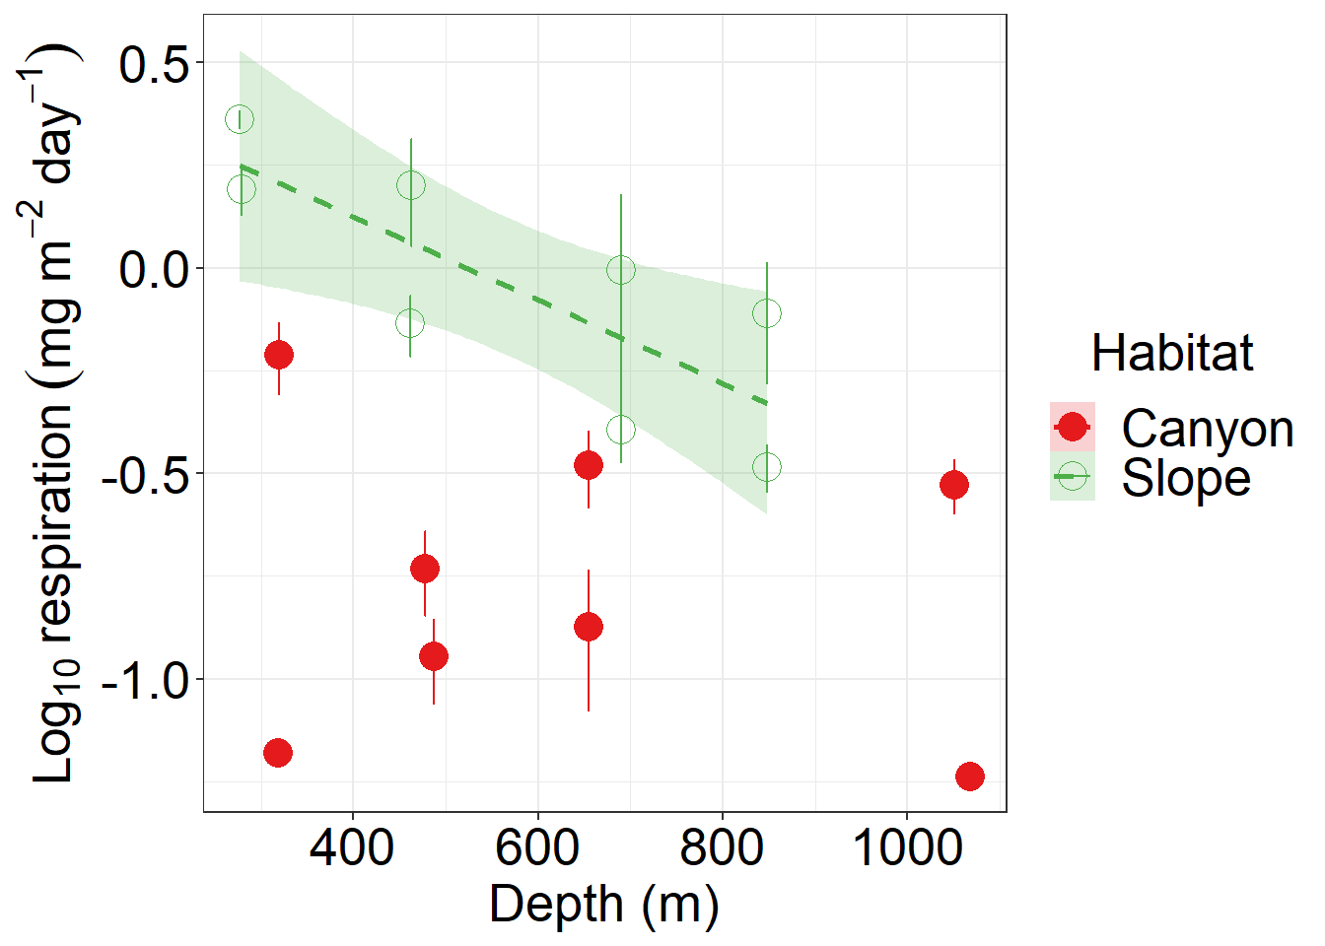
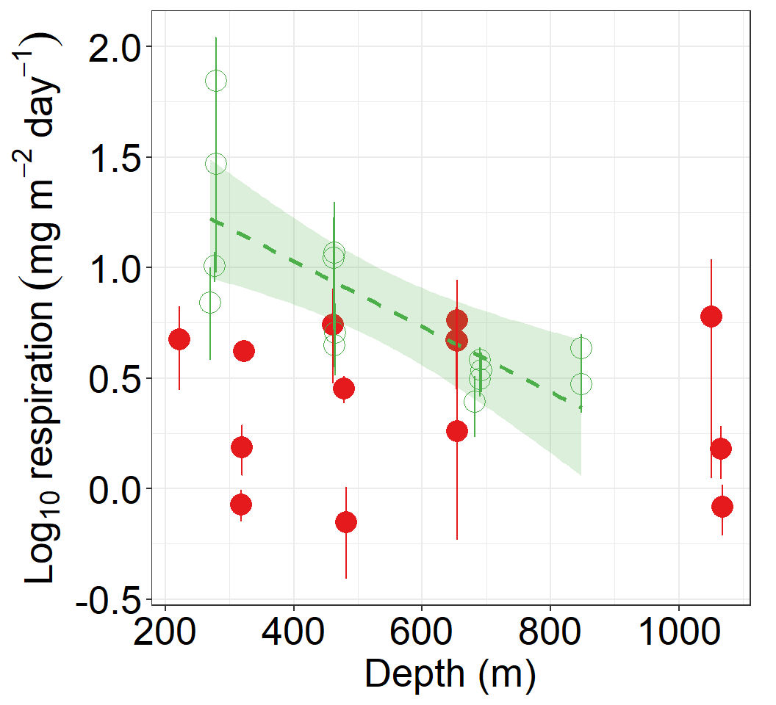
(A)
(B)
(C)
(D)
Notes:
Fig. 5. Mass-specific respiration and total respiration rate of meiobenthos (A, C) and macrobenthos (B, D)

Slide 6
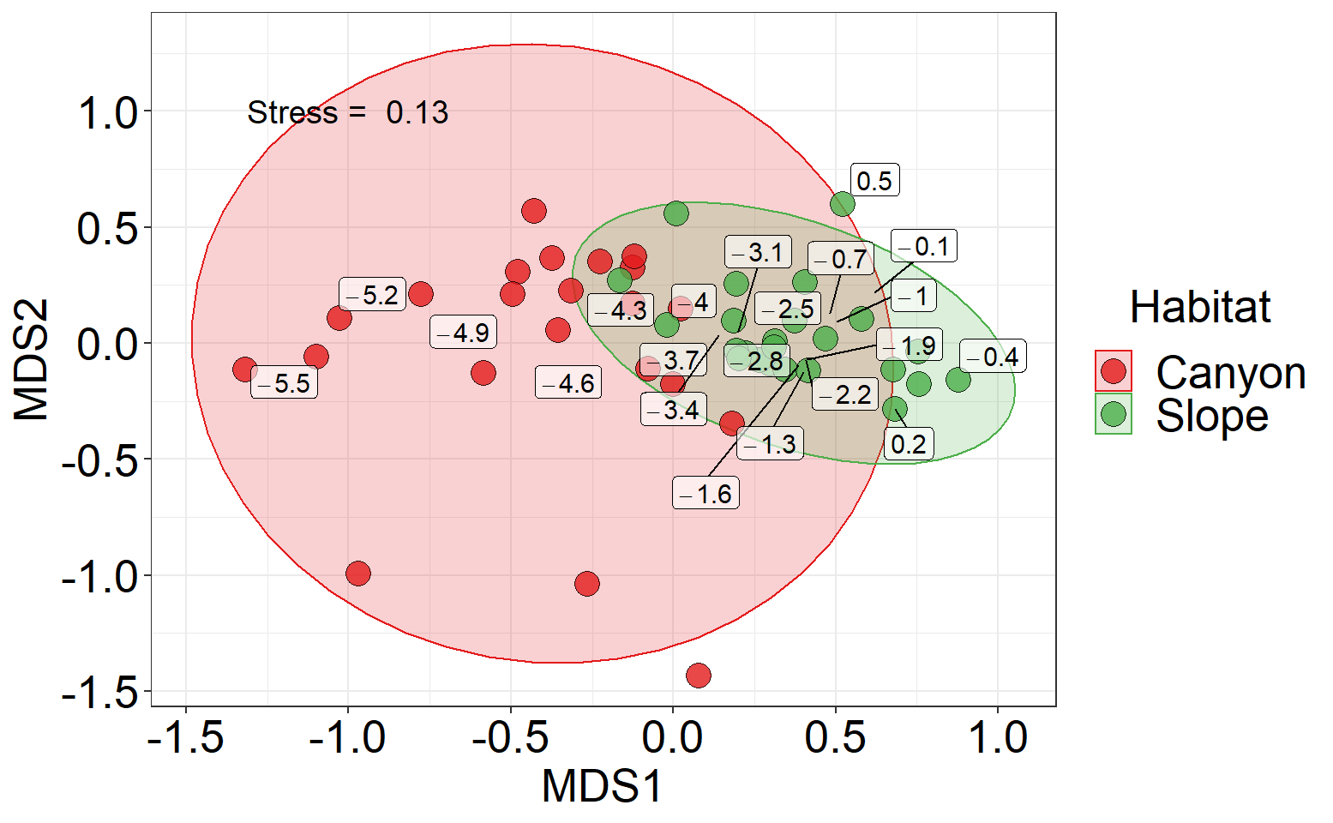
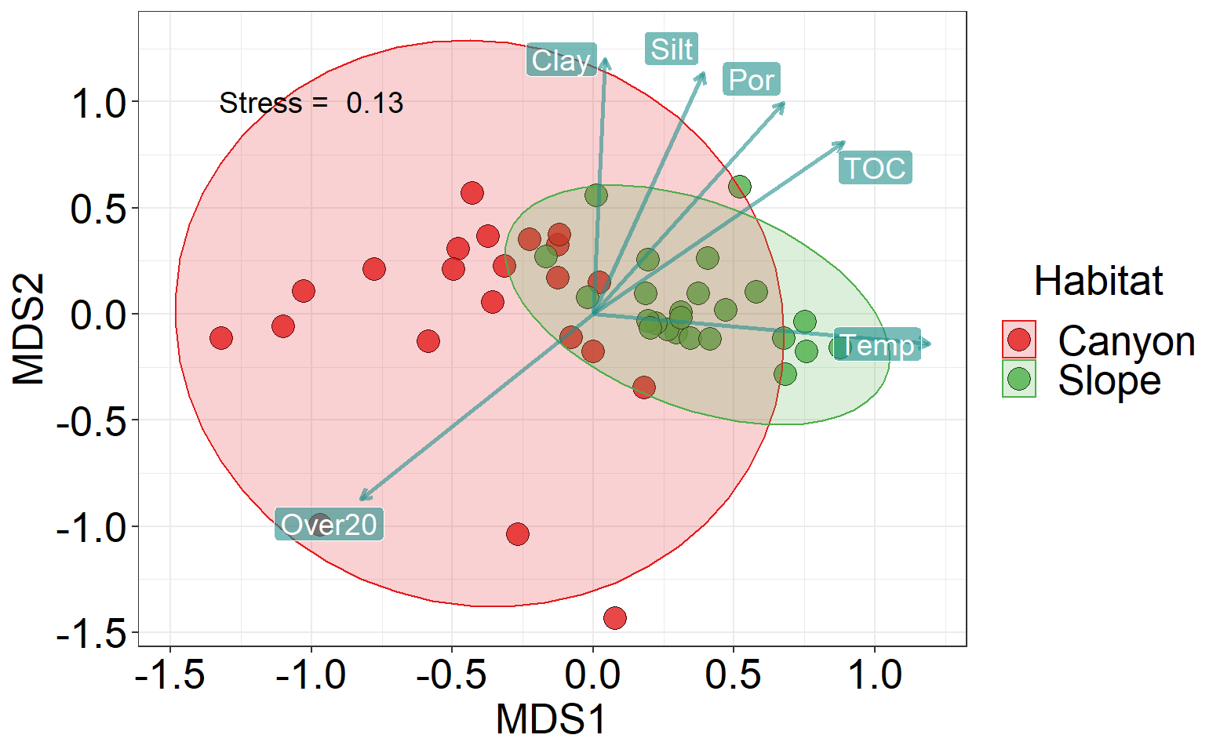
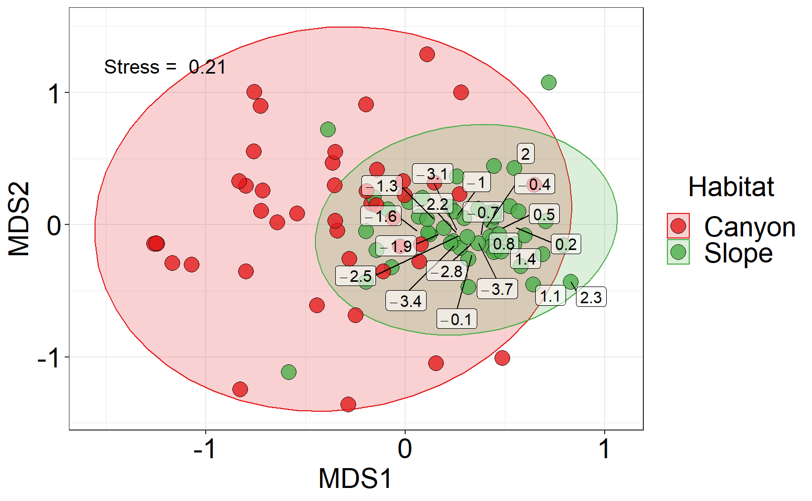
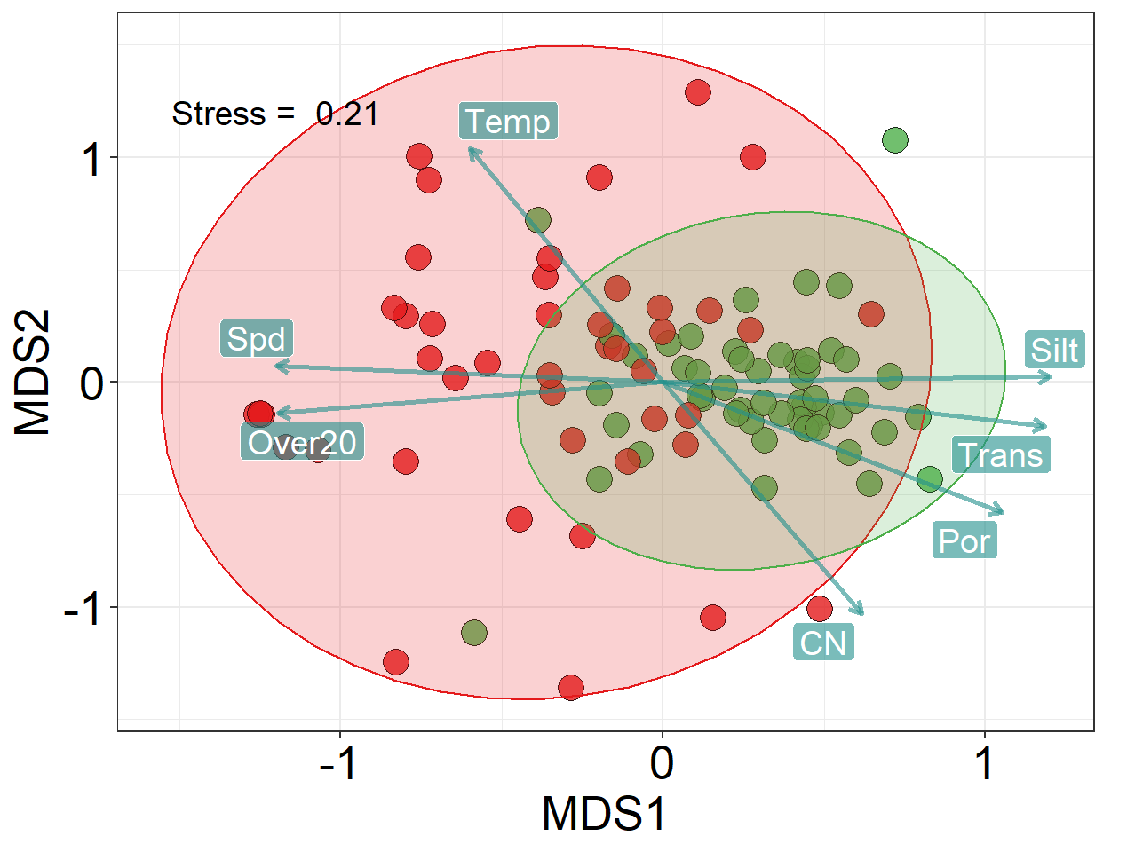
(A)
(B)
(C)
(D)
Notes:
Fig. 6 Body size composition of meiobenthos (A-B) and macrobenthos (C-D)

Slide 7
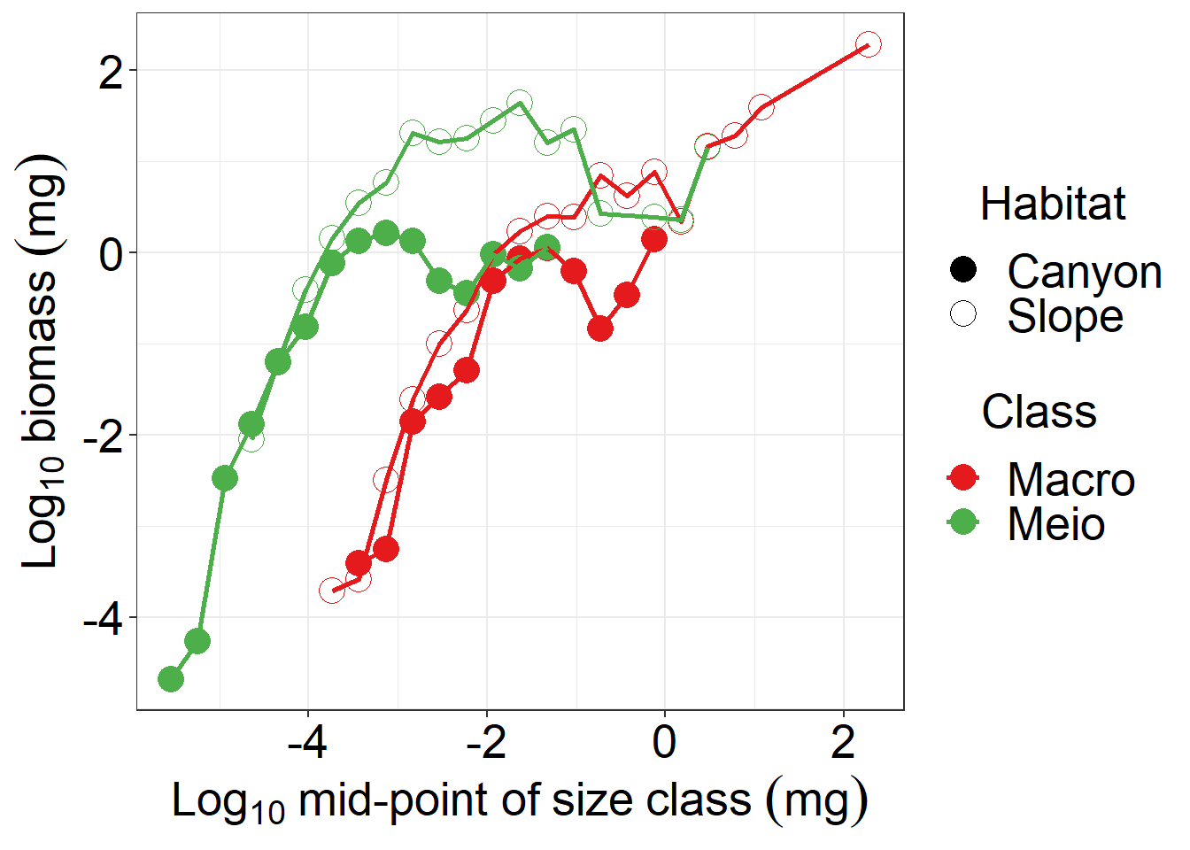
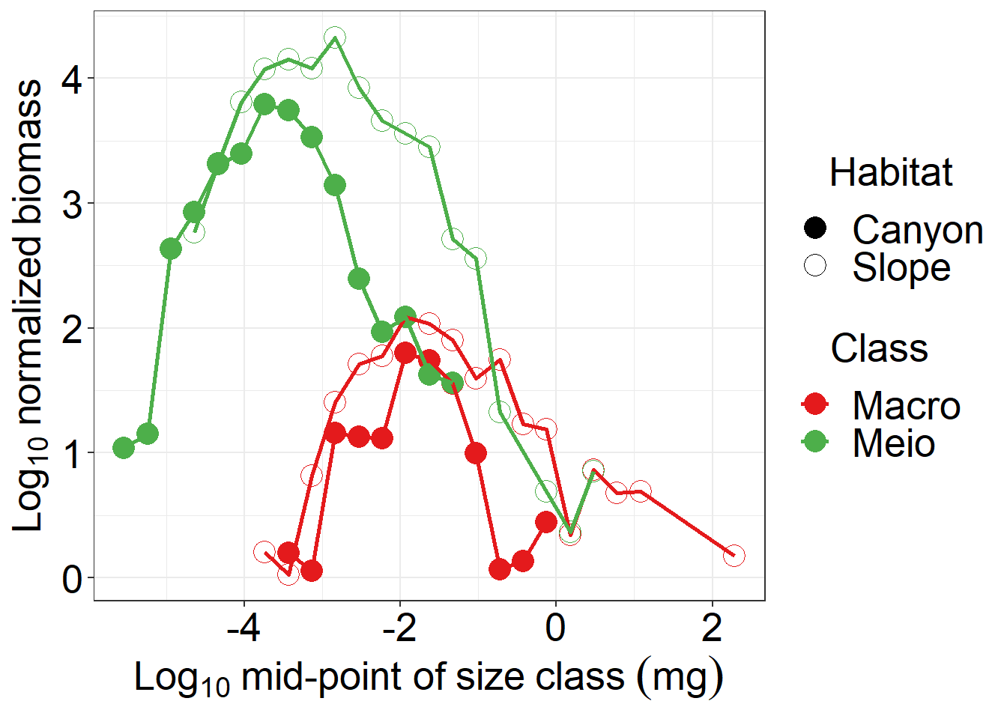
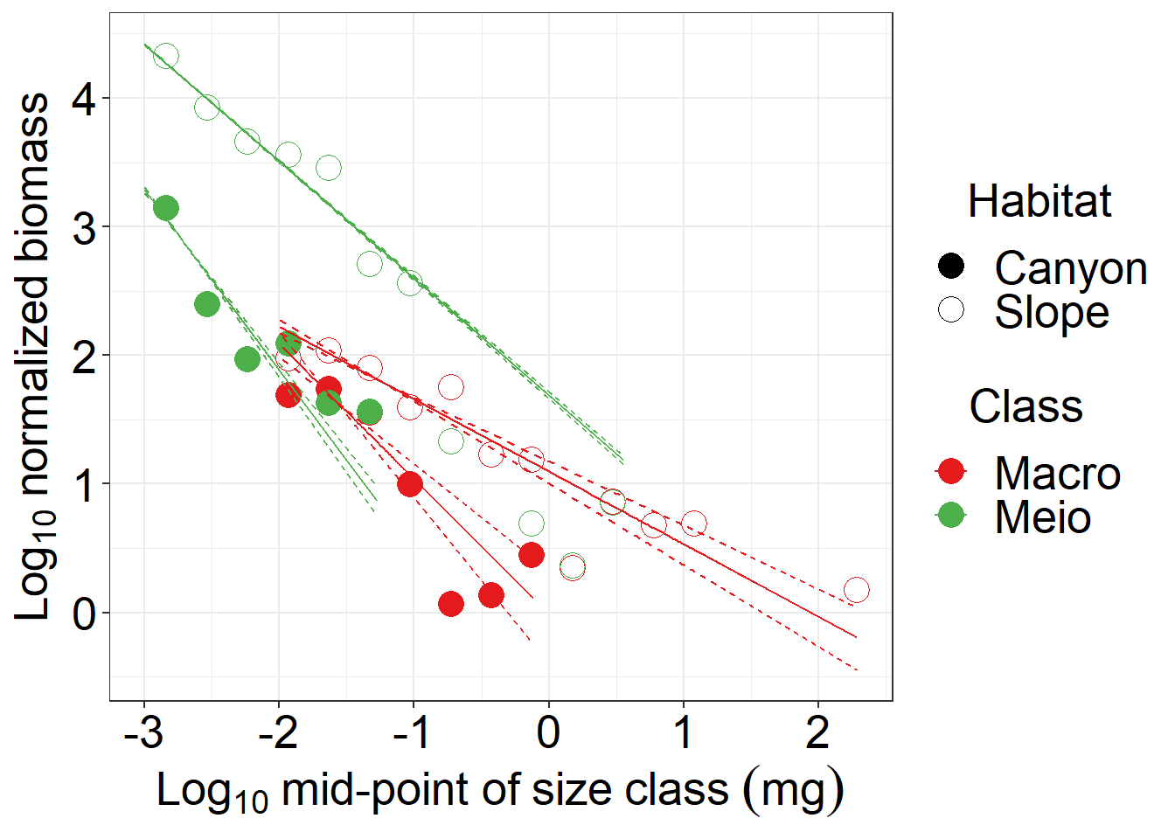
(A)
(B)
(C)
(D)
Notes:
Fig. S1 Size spectrum of meiobenthos and macrobenthos. The meiofauna were scaled to the total abundance in three multicore tubes by re-sampling the observed size measurements (with replacement).

